Slide 1

Design of Solar Panel Intercooled by Refrigeration System
Team #9
Advisor:
Dr. Nader Nader
Name:
Moayed Alkhaldi 201301836
Mohammed Aljaafri 201301559
Omar Albuaunain 201301173
Muath Alabdulathim 201301641

Slide 2
Presentation Content
Objective
Background and Motivation
Relevance
Engineering Standards
Design Specification & Constrains
Theoretical Calculation
Testing & Result
Experimental Setup
Future work
Summary
1
2
3
4

Slide 3
Project Objectives
Design a refrigeration system
Design a solar energy system
To Increase the efficiency of the solar system
Combined a refrigeration system with solar intercooling
Use renewable energy to produce power

Slide 4
Background and Motivation
The Importance of
Solar energy
Environmentally and Financially
Demand of renewable energy
Problem Working
How weather in Saudi Arabia
Decreasing of efficiency after 24 C
Aim of The Project
Solar Panel Intercooling
Saving the efficiency

Slide 5


Relevance
The U.S.
Solar Power Production
Vision 2030 of Saudi Arabia

Slide 6
Engineering Standards
Components | Engineering Standard | Details
Compressor | LG-ICTS | India Customized LG Test Standard
Water Pump | BSi | Specification for horizontal end-suction centrifugal pumps
Copper Coil | ASTM B280 | Refrigeration tube dehydrated
Thermal valve | SAE | Brass body Q valve adjustable.

Slide 7
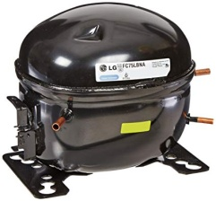
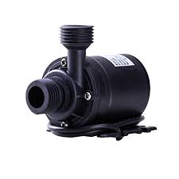
Engineering Standards
Compressor
Water Pump
Voltage: 220 V
Frequency: 50 Hz
Power: 60 W
Width: 0.28448 meters
Length: 0.2286 meters
Height: 0.2286 meters
Compact sizes: Measures 2.1 x 1.7 x 1.3 inches
2 Nozzles:1/2 inch & 1/3 inch
Max Flow Rate: 80 GPH
Max Lift Height: 2.6 ft.
03
04

Slide 8






Design specifications
Sustainability
Environmental
Social
Economic
Safety
Ethical

Slide 9
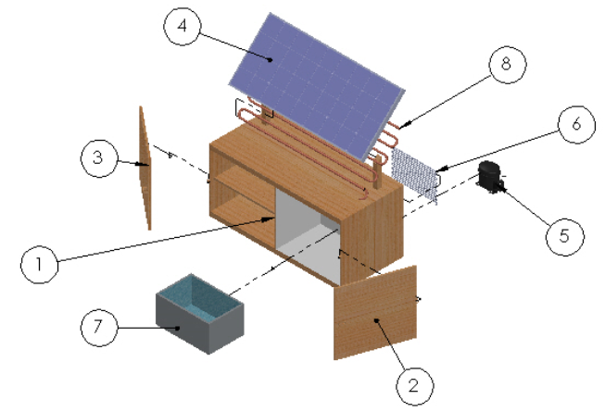
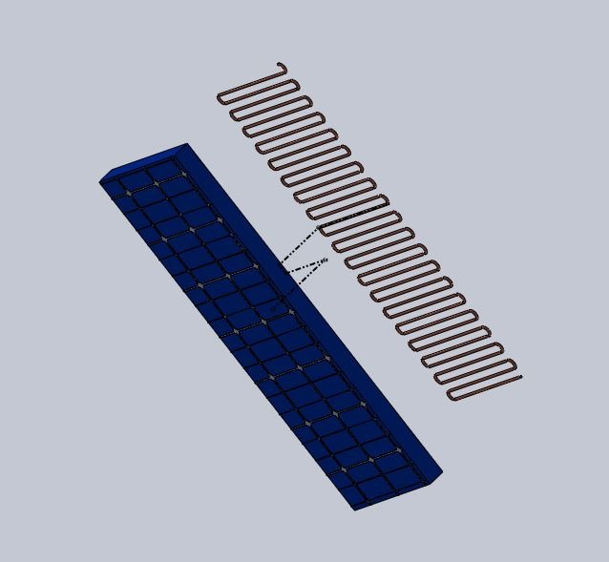
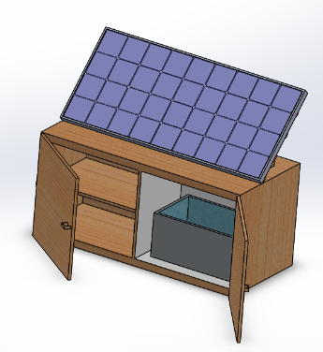
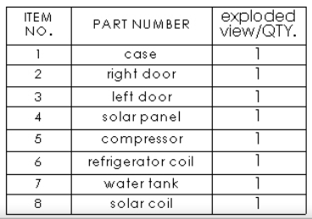
Design Constraints

Slide 10
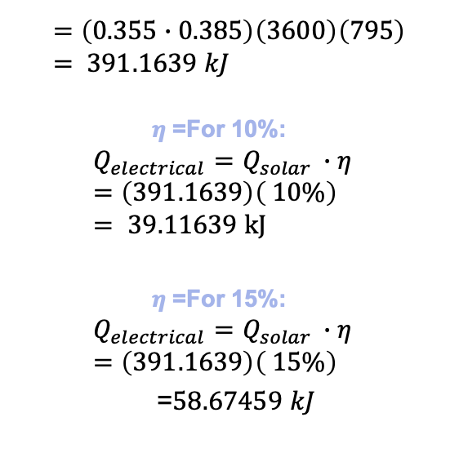
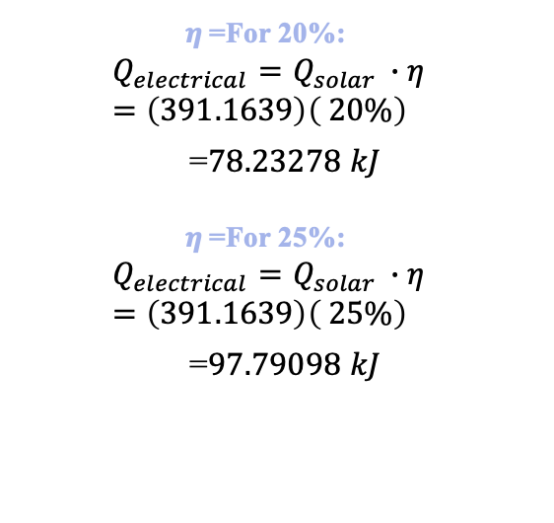
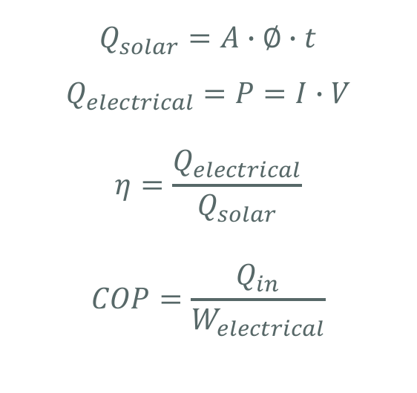
Theoretical calculations
$$Q_{solar}=A∙∅∙t$$
$$Q_{electrical}=P=I∙V$$
$$η=\frac{Q_{electrical}}{Q_{solar}}$$
$$COP=\frac{Q_{in}}{W_{electrical}}$$
$$=\left(0.355∙0.385\right)\left(3600\right)\left(795\right)= 391.1639 kJ$$
$$η\text{ =}\text{For}\text{ 10\%: }$$
$$Q_{electrical}=Q_{solar }∙η=\left(391.1639\right)\left( 10\%\right)= 39.11639 kJ$$
$$η\text{ =}\text{For}\text{ 15\%: }$$
$$Q_{electrical}=Q_{solar }∙η=\left(391.1639\right)\left( 15\%\right)$$
=$58.67459 kJ$
$$η\text{ =}\text{For}\text{ 20\%: }$$
$$Q_{electrical}=Q_{solar }∙η=\left(391.1639\right)\left( 20\%\right)$$
=$78.23278 kJ$
$$η\text{ =}\text{For}\text{ 25\%: }$$
$$Q_{electrical}=Q_{solar }∙η=\left(391.1639\right)\left( 25\%\right)$$
=$97.79098 kJ$

Slide 11
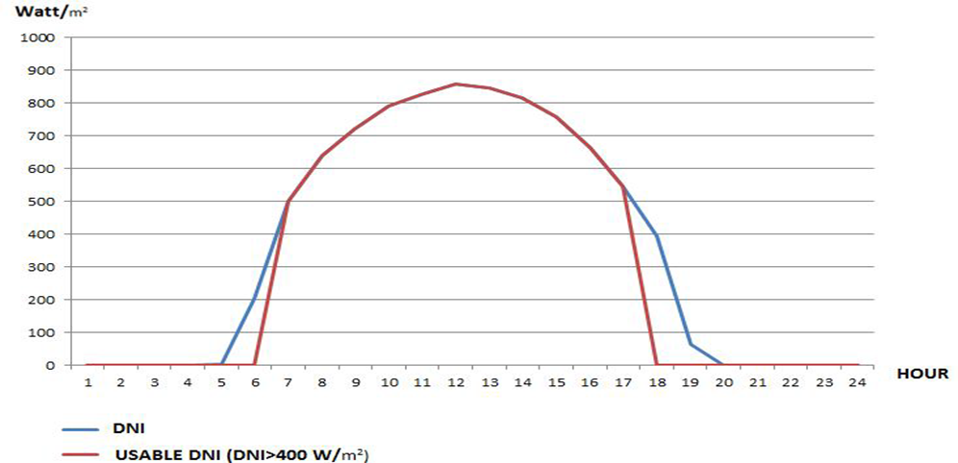

$$A=0.355∙0.385=0.136675 m^{2}, t= 3600 s$$

Slide 12
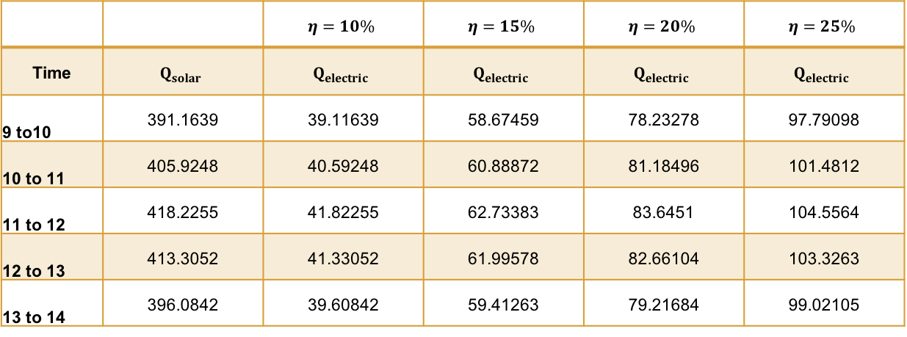
Theoretical calculations
If the η=10%, 15%, 20% and 25%:
Time
9 to10 | 391.1639 | 39.11639 | 58.67459 | 78.23278 | 97.79098
10 to 11 | 405.9248 | 40.59248 | 60.88872 | 81.18496 | 101.4812
11 to 12 | 418.2255 | 41.82255 | 62.73383 | 83.6451 | 104.5564
12 to 13 | 413.3052 | 41.33052 | 61.99578 | 82.66104 | 103.3263
13 to 14 | 396.0842 | 39.60842 | 59.41263 | 79.21684 | 99.02105

Slide 15
Testing & Result
Time | Ø | A | t | Qsolar | Q electric
9 to 10 | 795 | 0.034706 | 3600 | 993.2857 | 129.127
10 to 11 | 825 | 0.034706 | 3600 | 1030.768 | 129.815
11 to 12 | 850 | 0.034706 | 3600 | 1062.004 | 132.7505
12 to 13 | 840 | 0.034706 | 3600 | 1049.509 | 131.1886
13 to 14 | 805 | 0.034706 | 3600 | 1005.78 | 129.7456
14 to 15 | 798 | 0.034706 | 3600 | 997.034 | 129.614
15 to 16 | 793 | 0.034706 | 3600 | 990.7869 | 123.8483

Slide 16
Testing & Result
With cooling
Time | Ø | A | t | Qsolar | Q electric
9 to 10 | 795 | 0.034706 | 3600 | 993.2857 | 168.8585
10 to 11 | 825 | 0.034706 | 3600 | 1030.768 | 173.169024
11 to 12 | 850 | 0.034706 | 3600 | 1062.004 | 176.29266
12 to 13 | 840 | 0.034706 | 3600 | 1049.509 | 177.367021
13 to 14 | 805 | 0.034706 | 3600 | 1005.78 | 171.98838
14 to 15 | 798 | 0.034706 | 3600 | 997.034 | 171.4898
15 to 16 | 793 | 0.034706 | 3600 | 990.7869 | 166.45104

Slide 18
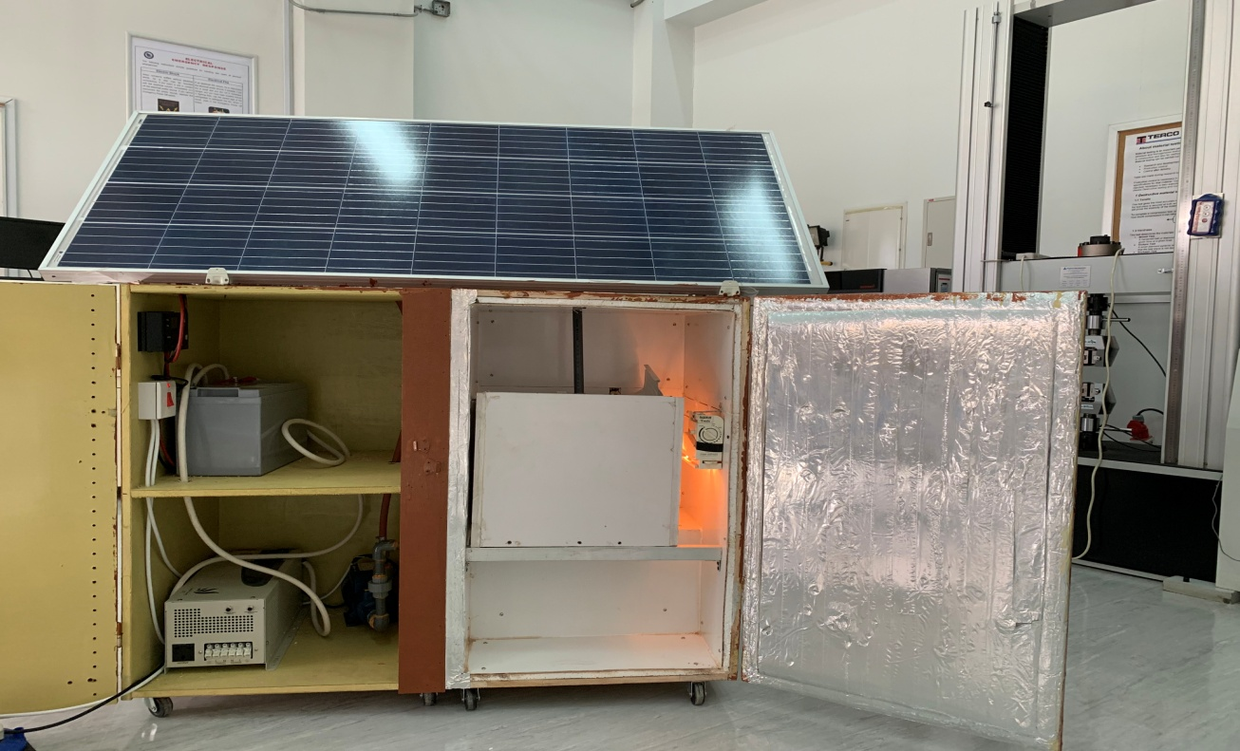
Experimental Setup
Solar Panel
Controller
Battery
Converter
Pump
Water Tank
Copper Coil
Pipes and fittings

Slide 19
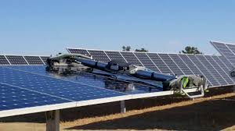
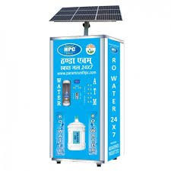
Recommendation & Future work
Simple Mechanism Cleaner. (Example of glass wiper)
Vending Machine. (Example of water machine)
Charging station. (Example in the waking area)

Slide 20
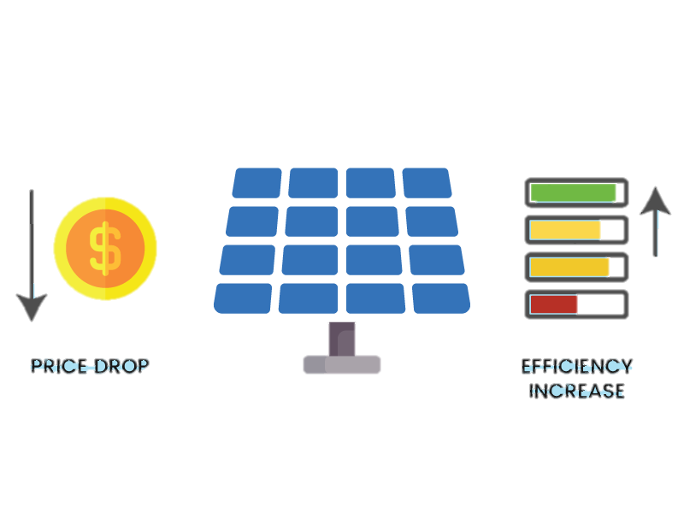
Summary
Our project aimed to use solar energy in effective way by using refrigeration cycle in order to cool the solar panel, and
that will increase the efficiency as the result shown.

Slide 21
Thank you

